Slide 1
Vehicle Routing Problem
CSE 424 Project Presentation

Slide 2
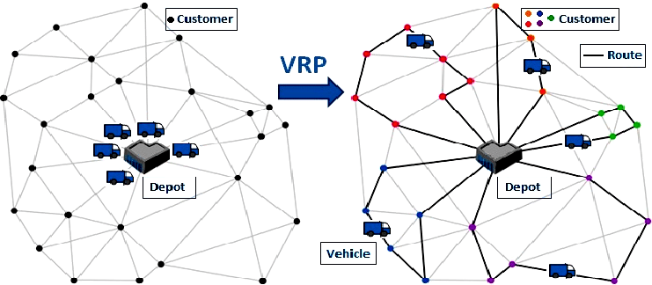
Problem Definition
Vehicle Routing Problem is a combinatorial optimization problem that aims to determine the most suitable routes for vehicles that will serve customers from one or more warehouses. It is a more general version of the Traveling Salesman Problem, one of the best-known problems in the optimization literature.

Slide 3
Solution Format
Solution format contains list of lists. Each sub-list represents a vehicle and the data contained in this sub-list is the order of the cities that the relevant vehicle will visit.

Slide 4
Decision Variables, Constraints, Objective Function
Decision Variables
Decision variables are vehicles for vertices in the graph data structure.
Constraints
Constraints are to visit all cities at once.
Objective Function
The graph data structure does not include the repository. There is a different data structure that contains the cost of each city from the warehouse.
The objective function is the sum of the cost of the route traveled by the vehicles and the cost between the first stop city and the warehouse.

Slide 5
Genetic Algorithm - Encode Solution
Genetic algorithms generally behave as if they convert the solution format to a bit string and enlarge each bit.
By my design, converting the solution to a bit string would break combinatoriality. That's why I'm separating the list of lists I mentioned earlier in a single list with a "-1" separator.
[-1 3 2 4 -1 0 5] means vehicle 1 go to 3, 2, 4 and vehicle 2 go to 0, 5.

Slide 6
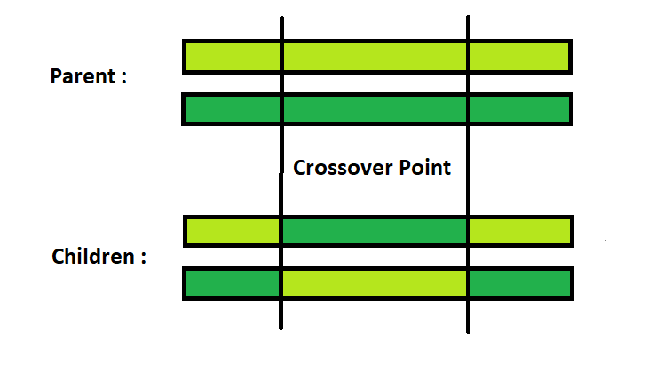
Genetic Algorithm - Crossover Operator
2-point crossover is used as crossover. Two points are selected and genes within this range are cross-inherited to the offspring.
Taken into account not to impair feasibility. For example, the "-1" setters in the solution list represent tools and are on the left, so the position of the left "-1" is not swapped.

Slide 7
Genetic Algorithm - Mutation Operation
As the mutation operation, the algorithm takes a parameter and this parameter is given in percent. If a mutation has to be applied after a probability calculation has been made, every child that emerges after the crossover will mutate. Mutation is the swapping of elements without breaking their feasibility.

Slide 8
Genetic Algorithm - Natural Selection Operation
After the crossover operation, the population size doubles and this population is divided into two as the best and worst solutions. The best solutions survive, while the worst ones are bypassed.

Slide 9
Variable Neighborhood Search - General Design
This algorithm includes 2 different sub-algorithms.
Shake Operation (Stochastic Part)
Local Search (Deterministic Part)

Slide 10
Variable Neighborhood Search - Neighborhood Structure
We talked about the encoded solution format before. Swapping two elements except the first element on this format is a neighborhood.

Slide 11
Variable Neighborhood Search Design - Stochastic Part
In this part, the process called "shaking" takes place. This action randomly swaps items up to the current level. The important point here is that the solution is coded in a customized format (This format refers to cars with -1 2 3 -1 4 5, the first car will go to the 2nd and 3rd city, the 2nd car will go to the 2nd city. . city) and trades are made through this list. The freshly shaken solution is then dissolved.
The level increases with each iteration.

Slide 12
Variable Neighborhood Search Design - Deterministic Part
Local search application is applied in this section. The solution is encrypted to the bitstring and neighbors are found because each element is swapped once with each element. It finds the best one among the neighbors and this process is repeated. If this process is at a point where it cannot be improved, the local optima points are reached and the current solution is solved and returned.

Slide 13
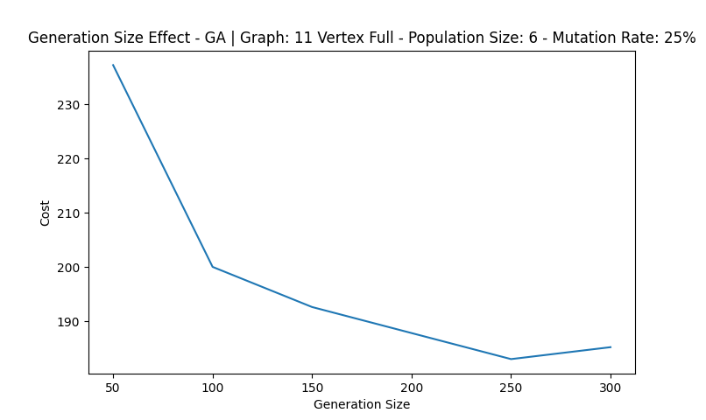
Generation Size Effect (GA) - Cost

Slide 14
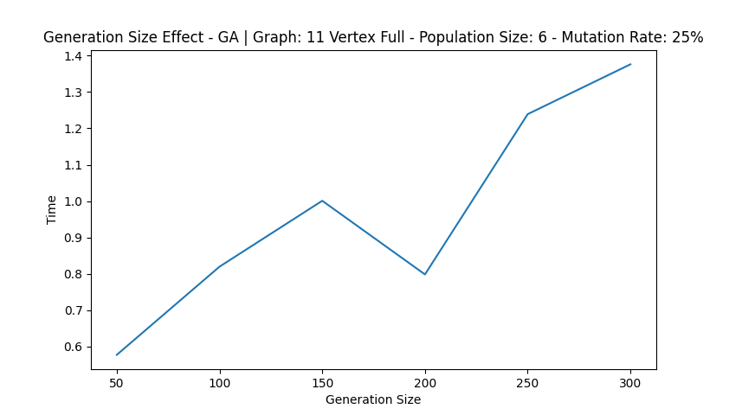
Generation Size Effect (GA) - Time

Slide 15
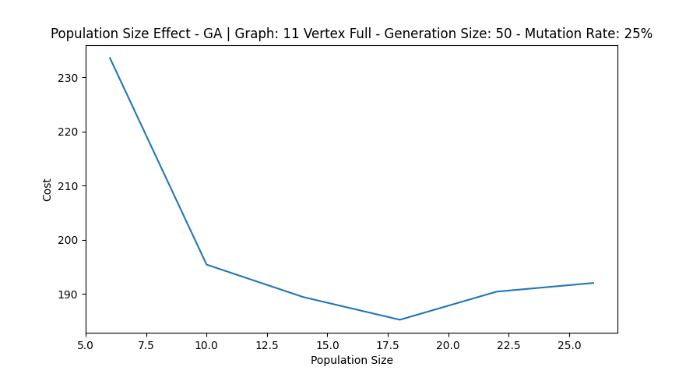
Population Size Effect (GA) - Cost

Slide 16
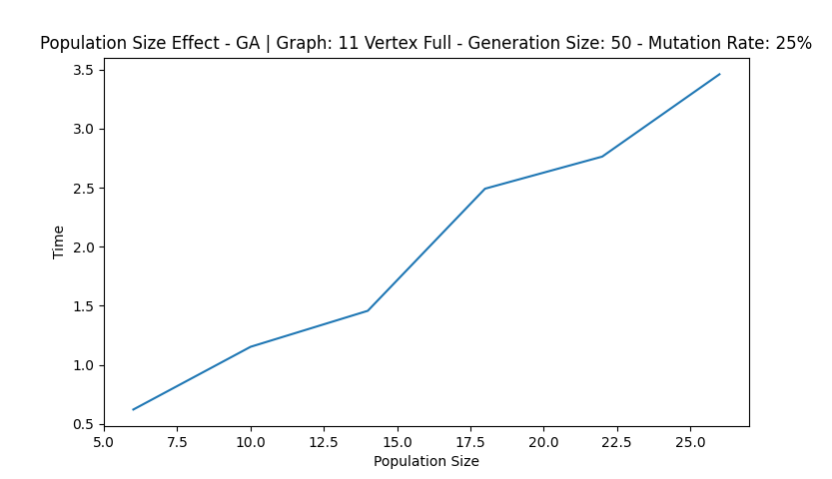
Population Size Effect (GA) - Time

Slide 17
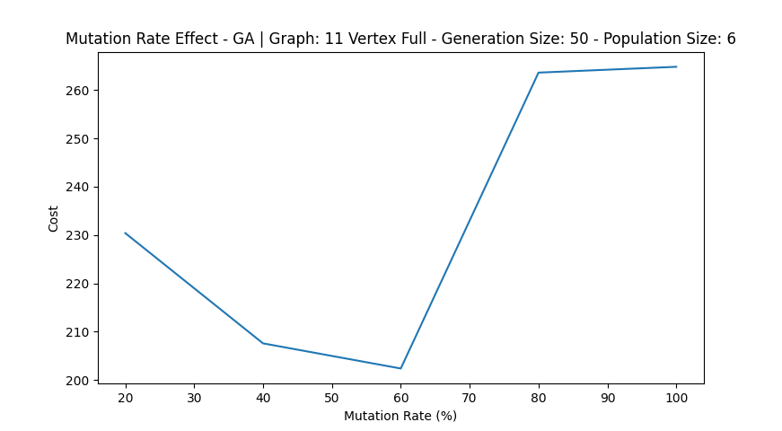
Mutation Rate Effect (GA) - Cost

Slide 18
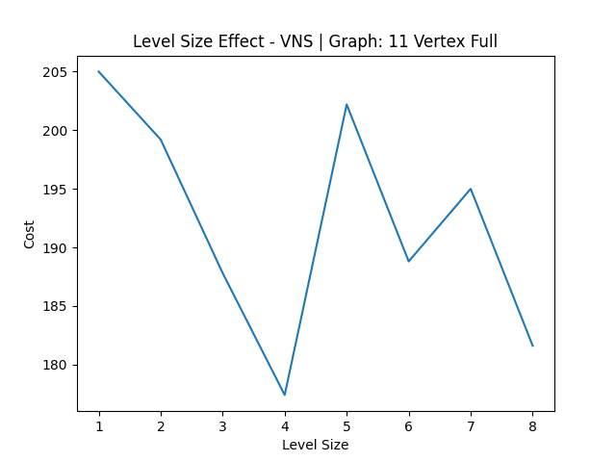
Level Size (VNS) - Cost

Slide 19
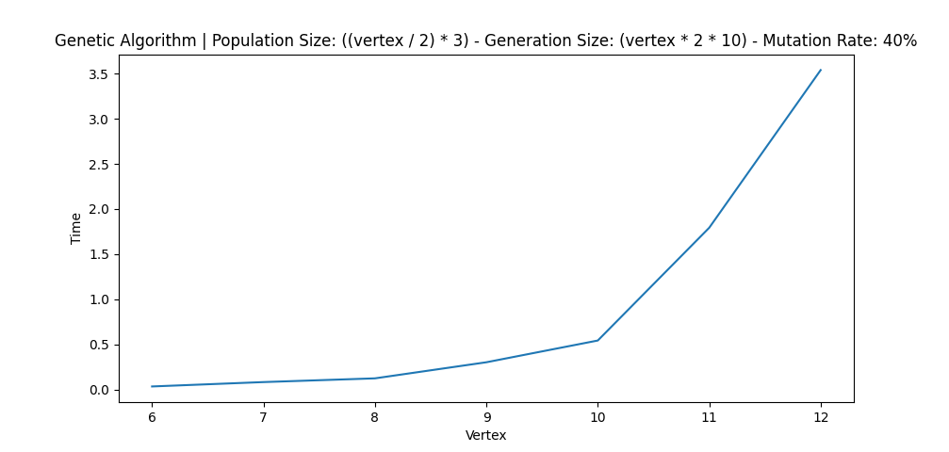
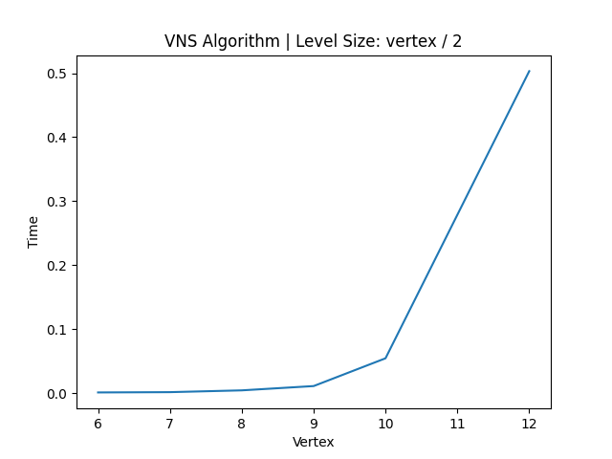
Time Comparison - GA vs VNS

Slide 20
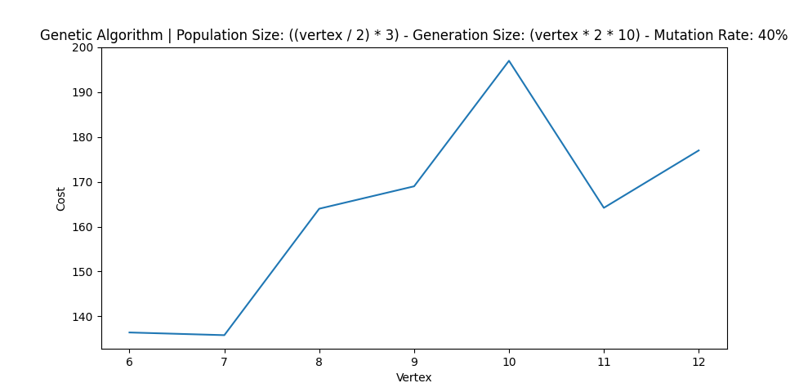
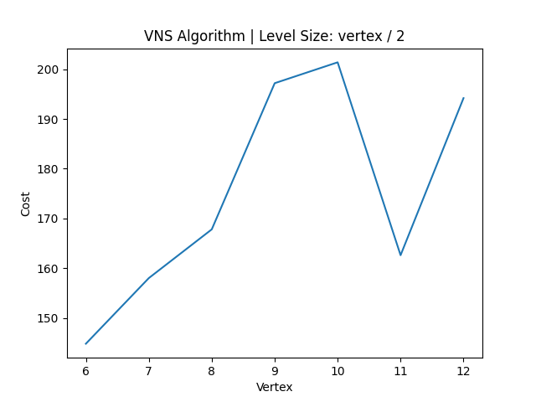
Quality Comparison - GA vs VNS

Slide 21
Benchmark Instance - GA vs VNS (br17.atsp)
Best Solution | Genetic Algorithm | Variable Neighborhood Search Algorithm
39 | 43 | 47

Slide 22
Resources
TSPLIB
Alsumairat, Nour, and Mahmoud Alrefaei. "Solving hybrid-vehicle routing problem using modified simulated annealing." International Journal of Electrical & Computer Engineering (2088-8708) 11.6 (2021).
Djikanovic, Jasenka, Dusan Joksimovic, and Mirko Vujosevic. "Application of Variable Neighbourhood Search Method for Vehicle-Routing Problems in an Integrated Forward and Reverse Logistic Chain." Acta Polytechnica Hungarica 12.5 (2015).
Mostafa, Salama A., and Mohd Sharifuddin Ahmad. "A Review of Genetic Algorithm Applications in Solving Vehicle Routing Problem"" Mazin Abed Mohammed," Mohd Khanapi Abd Ghani,“Omar Ibrahim Obaid." Journal of Engineering and Applied Sciences 12.16 (2017): 4267-4283.

Slide 23
Thanks for Listening

